Slide 1
CIS CONTROL 19: INCIDENT RESPONSE & MANAGEMENT-I
INCIDENT RESPONSE & MANAGEMENT

Slide 2
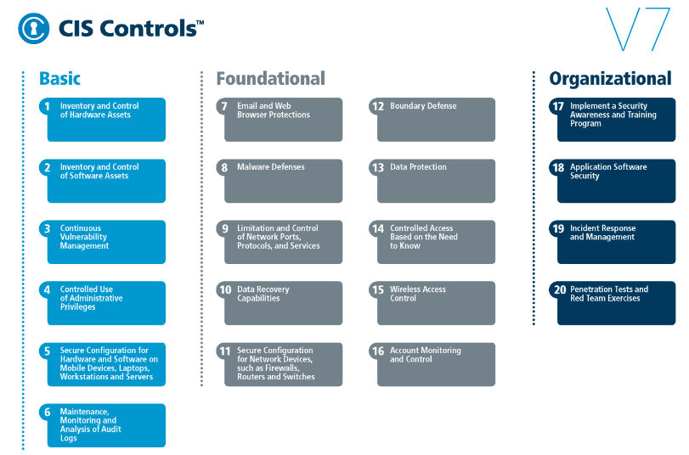
CIS CONTROL 19: INCIDENT RESPONSE & MANAGEMENT-I
https://www.cisecurity.org/controls/

Slide 3
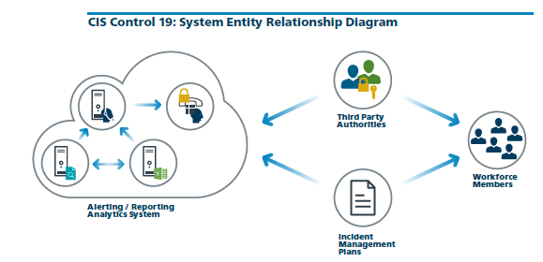
CIS CONTROL 19: INCIDENT RESPONSE & MANAGEMENT-I
https://www.cisecurity.org/controls/

Slide 4
CIS CONTROL 19: INCIDENT RESPONSE & MANAGEMENT-I
19.1: Document Incident Response Procedures
Ensure that there are written incident response plans that defines roles of personnel as well as phases of incident handling/management.

Slide 5
CIS CONTROL 19: INCIDENT RESPONSE & MANAGEMENT-I
19.2: Assign Job Titles and Duties for Incident Response
Assign job titles and duties for handling computer and network incidents to specific individuals and ensure tracking and documentation throughout the incident through resolution.

Slide 6
CIS CONTROL 19: INCIDENT RESPONSE & MANAGEMENT-I
19.3: Designate Management Personnel to Support Incident Handling
Designate management personnel, as well as backups, who will support the incident handling process by acting in key decision-making roles.

Slide 7
CIS CONTROL 19: INCIDENT RESPONSE & MANAGEMENT-I
19.4: Devise Organization-wide Standards for Reporting Incidents
Devise organization-wide standards for the time required for system administrators and other workforce members to report anomalous events to the incident handling team, …

Slide 8
CIS CONTROL 19: INCIDENT RESPONSE & MANAGEMENT-I
19.4: Devise Organization-wide Standards for Reporting Incidents
…the mechanisms for such reporting, and the kind of information that should be included in the incident notification.

